Slide 1
Introduction to Macro Economic Principles
Dr Sophia Kuehnlenz
s.kuehnlenz@mmu.ac.uk
Lecture week 2

Slide 2
Unit 10
BANKS, MONEY, AND THE CREDIT MARKET

Slide 3
What we talked about last week
Hockey-stick growth indicative of increased GDP per capita
Explanations for hockey-stick growth
  Industrial Revolution stipulated by technological progress (ongoing)
  Started at different times in different regions
Does increasing GDP per capita mean everyone is better off and happier?
  Check graphs on inequality
  Wellbeing measurable via per capita GDP growth?
Key concepts of capitalism (markets, firms, private property)
Effects of Industrial Revolution on environment
Remember: most explanations here are mainstream (there are other theories in economics with a different analysis, methodology, starting and end points)

Slide 4
What we will talk about today
The role of commercial banks and the central bank in the economy
In most markets, money is the medium of exchange.
  How do banks create money?
The role of financial markets and market evaluations

Slide 5
Income, Borrowing, Saving and the Balance sheet

Slide 6
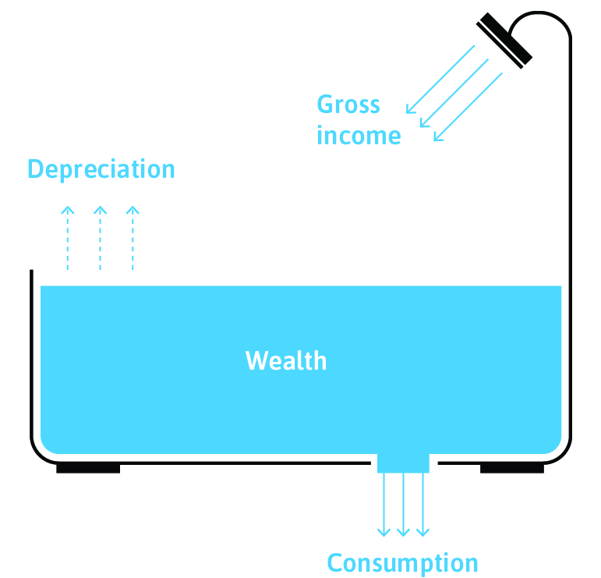
Income and wealth
Wealth: Stock of things owned or value of that stock.
  (Market value of) buildings, land, machinery, capital goods – debts owed + debts owed to you
Income: The amount of money one receives over some period of time (flow).
  From work, market earnings, investments, government.
  Assumption in this unit only: disposable income (after tax) = gross income
Stock: quantity measured at point in time
Flow: quantity measured per unit of time (annual income, hourly wage)

Slide 7
Other key concepts
Depreciation: Reduction in the value of a stock of wealth over time (flow variable).
Net income: The maximum amount that one could consume without running down wealth.
Net income = gross income – depreciation
Earnings: Wages, salaries, and other income from labour.
Consumption: Expenditure on goods and services
Savings: Income that is not consumed (bank deposits)
  Consumption expenditure is less than income
Investment: Expenditure on newly produced capital goods (machinery, equipment, buildings).

Slide 8
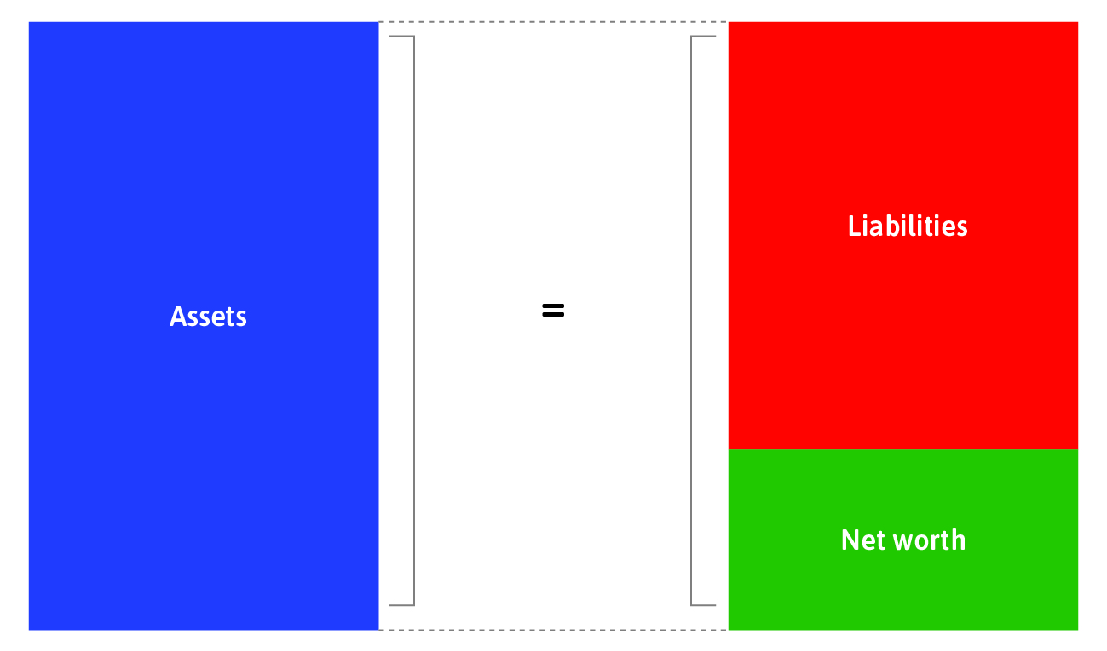
Balance sheet
A balance sheet summarises what the bank, household or firm owns, and what it owes to others.
Assets = Anything of value that is owned.
Liabilities = Anything of value that is owed.
Net worth (savings) = assets - liabilities

Slide 9
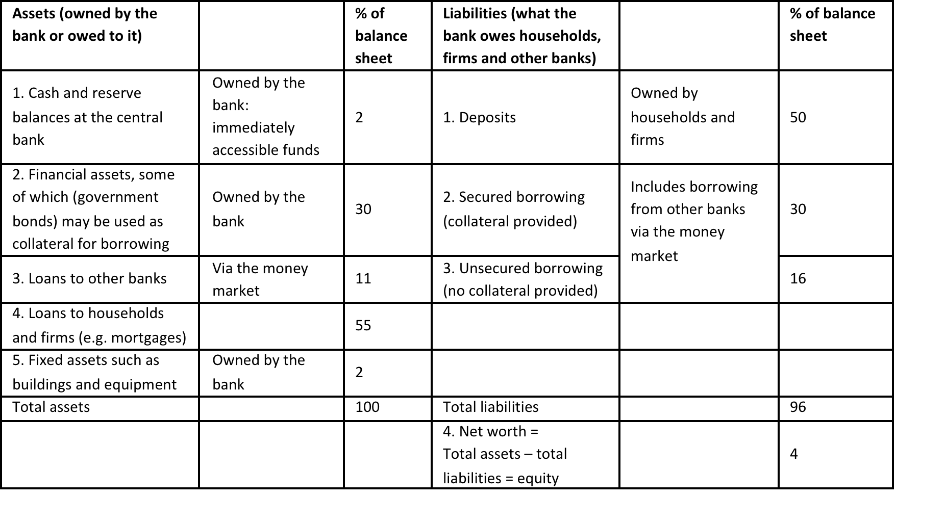
Commercial bank’s balance sheet
Balance sheets are not static but dynamic – What does this mean for the bc or boom and bust episodes?
Implications during crisis period?
Implications during crisis period?
Assets: bank lending
Liabilities: bank borrowing (deposits and other)
Liabilities > Assets: insolvency

Slide 10
Bank assets
Cash and central bank reserves: Item 1 on the balance sheet is the cash it holds, plus the bank’s balance in its account at the central bank, called its reserve balances. Cash and reserves at the central bank are the bank’s readily accessible (liquid) funds. This is base money and amounts to a tiny fraction of the bank’s balance sheet—just 2% in this example of a typical contemporary bank.
Bank’s own financial assets: These assets can be used as collateral for the bank’s borrowing in the money market. Banks borrow to replenish their cash balances when de­positors withdraw (or transfer) more funds than the bank has available.
Loans to other banks: A bank will also have loans to other banks on its balance sheet.
Loans to households and firms: The bank’s lending activities are the largest item on the asset side. The loans made by the bank to households and firms make up 55% of the balance sheet. This is the bank’s core business. Some of this will be secured lending. A loan is se­cured if the borrower has provided collateral. In the case of housing loans, called mortgages, the value of the house is the collateral. Other bank loans are unsecured, like overdrafts, credit card balances, and consumer loans.
Bank assets: Buildings and equipment will be recorded on the asset side of the balance sheet.

Slide 11
Bank Liabilities
Bank deposits, making up 50% of the bank’s balance sheet in this example. The bank owes these to households and firms. As part of its profit-maximization decision, the bank makes a judgement about the likely demand by depositors to withdraw their deposits. Any bank must ensure that it has cash and reserves at the central bank to meet the demand by depositors for funds, and the net transfers they have made that day. Banks aim to hold the minimum prudent balances of cash and reserves (opportunity costs).
For a typical bank, its equity is only a few per cent of its balance sheet.
Banks: very debt-heavy

Slide 12

Commercial bank’s balance sheet
Leverage ratio (for banks or households): to give you an idea how volatile a bank is.
The value of assets divided by the equity stake in those assets.
Here: 100/4 = 25 → bank’s total assets are 25 times of it’s net-worth
4% change in the value of the bank’s assets would make the bank insolvent (1/25) → that’s not much
The smaller the leverage ratio, the better (the less vulnerable the bank)

Slide 13
The Financial System, Banks, and Money

Slide 14
The financial system
Actors
Commercial banks
  Offer financial services (deposit, ATMs, loans ect.) and create money
The central bank
  Concerned with financial stability and economic growth
    Inflation-rate targeting via policy interest rate (more on this in wk 5)
  Lender of last resort
Pension funds
  Pension funds manage the contributions of employees and employers, purchase financial assets using those contributions, and pay out pension benefits at retirement
Other financial institutions (e.g. insurance companies, investment banks, payday lenders, and specialist lenders, such as mortgage providers in the housing market)
Recently: fintech companies
Households and non-bank firms are also part of the financial system when they buy, sell, borrow, lend, save, invest, and interact in other ways with banks and the central bank.

Slide 15
The financial system
Markets
Money market, stock market, housing market, and other financial markets (e.g. for government and corporate bonds, derivatives, and other financial assets)
Central bank and commercial banks lend to each other and other financial institutions in the money market
Companies make initial public offerings (IPOs) using the stock market
  IPO: shares in a company are sold to the general public for the first time and then traded on stock exchange
Housing market with important role in the economy
  Houses as main form of wealth of households (except for the very rich)
  Households borrow long term from banks or specialist mortgage lenders to buy houses

Slide 16
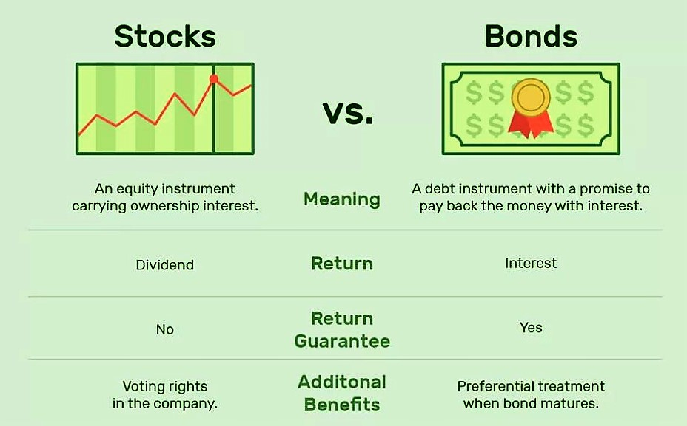
The financial system
Financial assets: Stocks and bonds
Both are a financial instrument to raise money through financial markets (and not via a bank loan)
Source: The Balance (2018)

Slide 17
What is money?
Physical (bank notes and coins) and digital (e.g. credit card, debit card)
In modern economy (with fiat currency) money is an IOU – liability based money
  When money is created (CB or commercial bank) – liability is created
  Possession of liability money: commercial bank or the central bank owes that amount, and someone else will accept a transfer of all or part of that debt via electronic transfer or currency as a means of payment.
Three types of money:
Cash: coins and bank notes (liability of the CB – risk free)
  For the UK: 3% → cash might/will be replaced in the future (CBDC’s)
Reserves: commercial bank accounts at the central bank (liability of the CB – risk free)
  For the UK: 18%
Bank deposits: your account with a commercial bank (liability of commercial banks – not risk free)
  For the UK: 79%
Notes:
Source: https://www.bankofengland.co.uk/knowledgebank/how-is-money-created

Slide 18
Functions of money
Medium of exchange: generally accepted to purchase goods or services
Unit of account: e.g. clothing will be denominated in BP and not apples
Store of value: your income today will buy the same goods and services tomorrow or a week/ year from now than it would now
For money (in a fiat currency system) to do its work, everyone must trust that others will accept your money as payment.
  Money can be used by everyone to buy goods and services (which are sometimes payed at later date)
  Trust created: Stable government institutions (e.g. FED system, BoE, ECB)
    Money issued by government (CB) as legal tender (usage enforced via taxes)

Slide 19
Central bank and central bank money
The central bank is the only bank that can create legal tender.
Not private entity but owned by government (nationalised)
Not profit driven but concerned with overall financial and monetary stability (e.g. via inflation targeting – more on this in week 5)
Acts as the banker for the commercial banks, who have accounts at the central bank
Lender of last resort (especially during crises – liquidity provision)
Sets the policy interest rate
CB money (base money, risk-free money):
Cash held by households, firms, and banks
Balances held by commercial banks in their accounts at the central bank (reserves)
Liability (IOU) of the central bank → no default risk (risk-free)
CB creates money by crediting commercial bank accounts (digital money) and/ or by printing cash and creating coins (physical money)

Slide 20
Commercial banks
Commercial banks are private entities with a focus on profit
Banks borrow from households (deposits), other banks, and the central bank.
The interest they pay on deposits is lower than the interest they charge on loans (lending rate), which is how banks make profits.
Commercial bank money:
Households’ and firms’ deposits at commercial banks (digital money) called (commercial) bank money
Commercial bank money is the liability (IOU) of commercial bank → not risk-free
Commercial banks create money by giving out loans to their customers (endogenous money creation)→ money supply in the economy increases
How is this done?

Slide 21
Creation of commercial bank money example
Gino has an account with bonus bank and receives a loan
Here: we are looking at the changes in the bank‘s balance sheet (similar for Gino‘s balance sheet)
Bonus Bank gives Gino a loan of £100
Bonus Bank’s assets | Bonus Bank’s liabilities
£20 cash deposit by Gino | £20 payable on Gino’s demand
£100 bank loan | £100 payable on Gino’s demand
Total: £120 | Total: £120 payable on Gino’s request
Bonus Bank balance sheet
Bonus Bank’s assets | Bonus Bank’s liabilities
£20 cash deposit by Gino | £20 payable on Gino’s demand
Total: £20 | Total: £20 payable on Gino’s request
Newly created commercial bank money (digital form): £100
  The total money in the banking system has grown by £100

Slide 22
Default risk and liquidity risk
Banks are important for capitalist economies
Banks provide the service of maturity transformation:
Deposits can be withdrawn at any time
But loans only need to be repaid after a specified time (e.g. mortgages)
→ Banks borrow short term and lend long term
This is also liquidity transformation:
Deposits are liquid (can be turned into cash quickly)
Loans to borrowers are frozen (illiquid)
  This exposes the bank to risks:
          Default risk (loans might not be paid back)
          Liquidity risk (assets might be tied up long term which could become an issue short term if more people want to withdraw funds in a short period of time)

Slide 23
The money market
Banks need enough base money to cover their net transactions.
  They borrow money on the money market (often from other banks) at the short-term interest rate (less than a year) → ensure banks’ liquidity
Short term interest rate determined by:
The demand for money
  Depends on how many transactions commercial banks have to make.
The supply of base money
  Decision by the central bank
Reminder Base money: Cash held by households, firms, and banks, and the balances held by commercial banks in their accounts at the central bank, known as reserves. → CB money

Slide 24
Credit rationing

Slide 25
Principal-agent problem in credit markets
Principal-agent problem: conflict of interest between principal (e.g. bank) and agent (e.g. household or firm), about some hidden action or attribute of the agent that cannot be enforced or guaranteed in a binding contract.
E.g. Financing a project
  Lenders face the risk that money borrowed will not be repaid
  Lack information about the project’s success or borrower’s effort so cannot ensure that the project succeeds

Slide 26
Equity and collateral
We know there is a default risk attached to each loan. How can uncertainty of whether default is likely or not be reduced?
Two possibilities (among other evaluation instruments):
Equity: the lender may require the borrower to put some of her wealth into the project
Collateral: the borrower has to set aside property that will be transferred to the lender if the loan is not repaid (e.g. mortgages – house as collateral)
Implications for borrowers with no collateral?
Implications during crisis episodes?

Slide 27
Credit rationing
Those with less wealth find it more difficult to provide equity or collateral.
Credit rationing: when those with less wealth
Borrow on unfavourable terms compared with those with more wealth (credit-constrained – predatory lending)
Or are refused loans entirely (credit-excluded - redlining)

Slide 28
Summary
1. Outline of the banking system
Banks create money (lend) to make profits
Issues: principal-agent problem, credit constraints or credit exclusions
2. What is money?
In fiat currency systems: IOU
Functions of money have to be fulfilled
Types of money (risky and risk-free; physical and digital)

Slide 29
Next week
Aggregate measures of the economy
  GDP and inflation
Business cycle, growth and fluctuations
  How households deal with fluctuations in income and employment (consumption smoothing)
  The effect of firms and investment decisions on the business cycle

